Slide 1

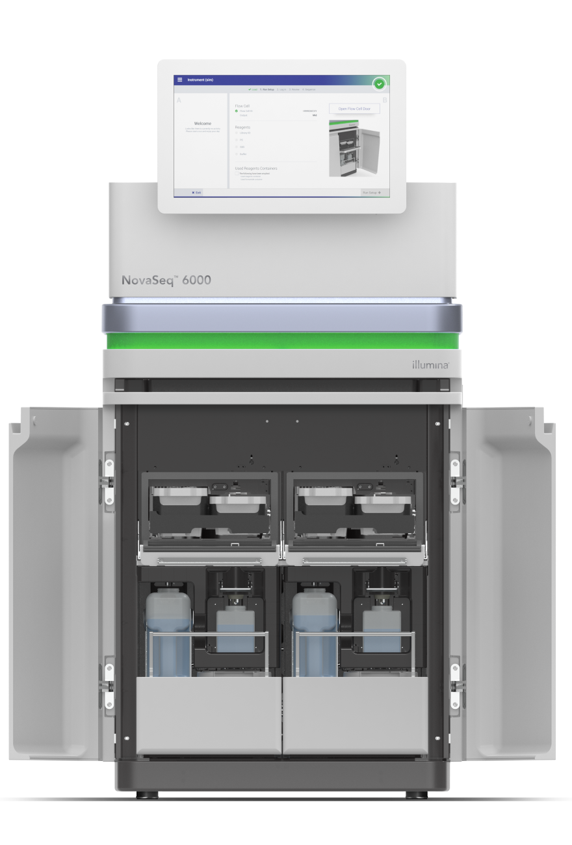
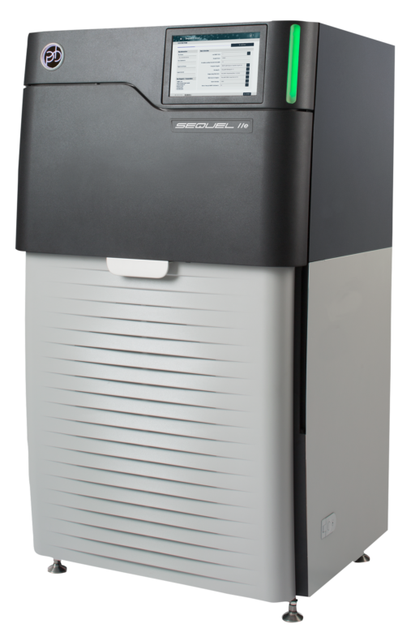

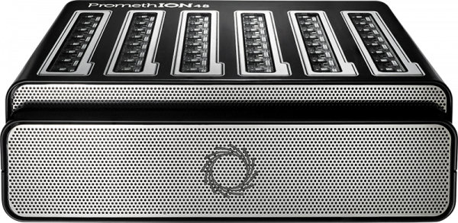





1
Obtaining Genomic Sequencing Data
Generating Sequencing Data
Downloading Real Sequencing Data
Simulating Sequencing Data
A
DNA Extraction
D
Sequencing
Illumina
ONT
PacBio
.FASTA/.FNA
B
DNA Fragmentation
C
Library Preparation
Multiple images
Squiggle
30-hour movie
Genome in a Bottle
.BCL/.CBCL
.FAST5
.BAM
.FASTQ/
.FASTA/.FNA
.FASTQ
2
Basecalling
3
Quality Control
Illumina
ONT
PacBio
.FASTQ
Lane | Tile | X | Y | Cycle 1 (A, C, G, T)
5 | 12 | 224 | 159 | 140, 20, 30, 10
5 | 12 | 500 | 100 | 10, 30, 40, 50
5 | 12 | 400 | 140 | 100, 10, 40, 140
5 | 12 | 30 | 120 | 40, 20, 30, 110
Read
Consensus Sequence
Trimmed read
.FASTQ
.FASTQ
.FASTQ
.FASTQ
4
Read Mapping
A
Indexing
B
Seeding
C
Pre-alignment Filtering
D
Sequence Alignment
.FASTA/.FNA
.FASTQ
Filter 1
Filter 2
Filter N
Read
Reference Genome
Read
Dynamic
Programming
Matrix
Seeds
Seeds
Seed content
Seed locations
Locating common seeds
Reference Subsequence
1, 4, 6
3, 5, 12
50, 52
2, 100
Locations of common seeds
1, 4, 6
3, 5, 12
2, 100
.SAM/.BAM
5
Variant Calling
A
Processing Mapping Data
B
Variation Classification
C
Generating Variant Calls
.SAM/.BAM
Reference
A | G | A | A | G | T | T | G | C | A | T
A | G | A | A | G | T | T
 |  | A | G | G | T | T | G | C | A
 | G | A | G | G
 |  | A | G | G | T
Aligned Reads
List of variants
CHR | POS | ID | REF | ALT
Chr 1 | 113834946 | rs2476601 | A | G
Removing read duplicates and cleaning read mapping results
.VCF
Notes:
Overview of a typical genome analysis pipeline. 1) The genomic sequencing data is first obtained through sequencing a new sample, downloading from publicly-available databases, or computer simulation. Sequencing starts with (A) extracting the DNA, (B) fragmenting it, (C) preparing its library, and (D) using sequencing machines for providing raw sequencing data. 2) The raw sequencing data needs to be converted into read sequences of A, C, G, T in DNA alphabet using basecalling techniques. The basecalling techniques are sequencing technology dependent. 3) To ensure high quality sequencing reads, a quality control step is performed to filter out low quality subsequences of a read or an entire read sequence. 4) Read mapping step is performed to locate each read sequence in a reference genome. Read mapping is four steps: (A) indexing the reference genome, (B) extracting seeds from each read and locating common seeds with the index, (C) pre-alignment filtering dissimilar sequence pairs, and (D) performing sequence alignment for every sequence pairs that pass the filtering. 5) Detecting and inferring genomic variations, which is usually three steps: (A) processing the read mapping data for increasing its quality, (B) classify variations between mapped reads and a reference genome, and (C) identifying genomic variations.

